Slide 1






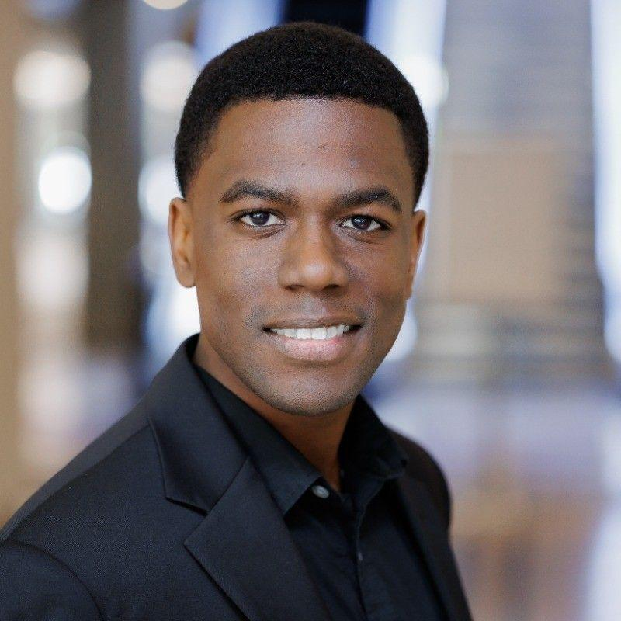


WORKSHOPS
Hands on Workshop
OpenAI's Fine-Tuning API
Zero Shot Labs x San Francisco AI User Group
Daryle Serrant
Data Scientist & ML Consultant
byteSolid Solutions

Slide 2


During this workshop you will…
Setup a dataset for fine-tuning GPT-3.5 Turbo
Finetune GPT-3.5-turbo on a custom task
Deploy and test fine-tuned model

Slide 3
Table of Contents / Agenda
1
Tech Overview [20 Minutes]
2
Hands-on Practice [20 Minutes]
3
Final Quiz

Slide 4
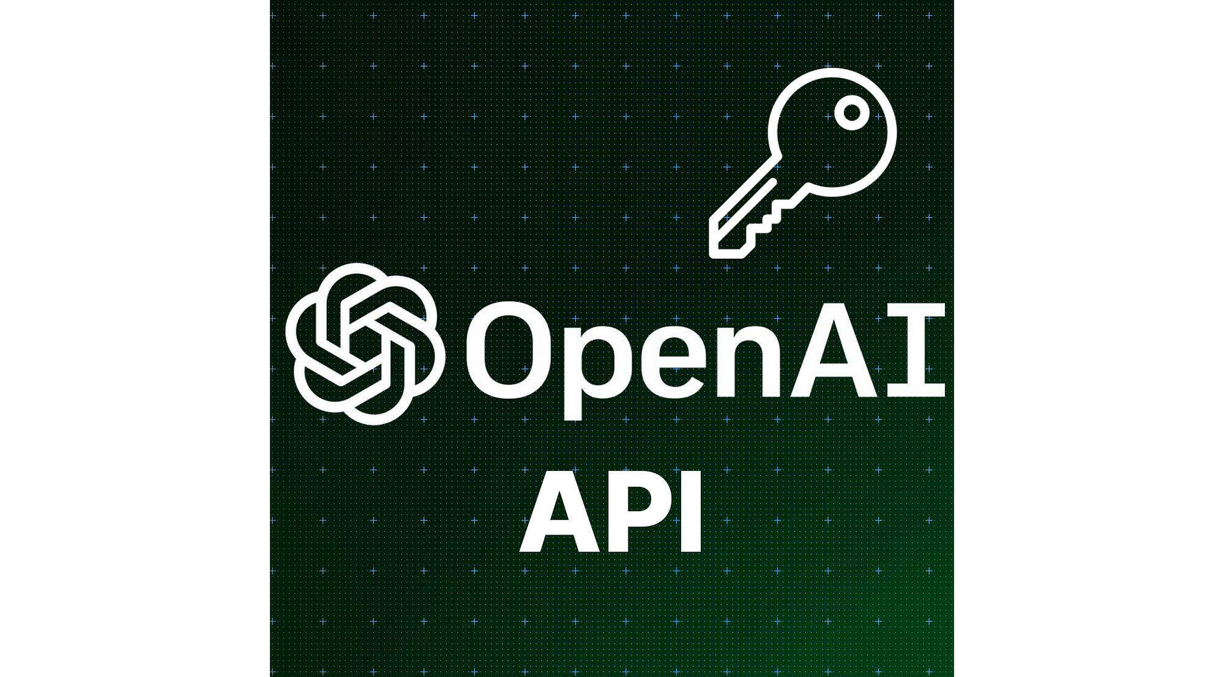



Prerequisites
1
OpenAI API Key
2
Familiarity with Python and Google Colab
3
Familiarity with Prompting / Large Language Models (LLMs)

Slide 5


Tech Overview

Slide 6
Improving GPT-3.5 Performance
Prompt Engineering
Information Retrieval
Function Calling
Fine-Tuning
Notes:
How to improve performance of GPT3.5 Turbo?
Prompt Engineering
Information Retrieval
Function Calling
Fine-Tuning
Few-Shot Learning
When it is easier to show than to tell

Slide 7

Advantages of Fine-Tuning
Improved Model Performance
Improved steerability
Reliable output formatting
Custom tone
Shortening prompts
Notes:
Advantages of Fine-Tuning
Fine Tuning is performed for:
Improved Model Performance
Improved steerability
Reliable output formatting
Custom tone
Shortening prompts
Early testers reduced prompts by up to 90%
Save money and inference time
Most Powerful when used alongside prompt engineering, information retrieval and function calling
Improved Model Performance: Fine-tuning allows the model to learn from a more relevant context, resulting in superior results compared to the base model. By incorporating specific examples and prompts, the fine-tuned version becomes more adept at generating text tailored to the desired use case.
Few-Shot Learning: Fine-tuning enables the model to quickly adapt to new tasks or narrow tasks with just a few examples. This capability is particularly useful when dealing with limited labeled data, cutting down on the time-consuming data collection and annotation process.

Slide 8
Fine-tuning Limitations
Difficult to add new knowledge to LLM’s memory
Best used for steering LLM in certain directions
Notes:
Notes on Fine-Tuning
Difficult to add new knowledge to LLM’s memory via fine-tuning (information retrieval is better option)
Better used for steering the LLM it in a certain direction i.e. converts model from few-shot to zero-shot performance model

Slide 9
Common Use-Cases
Set the style, tone, format, or other qualitative aspects
Improve consistency in generating desired output
Correct failures in following complex prompts
Handle edge cases
Train model to perform tasks difficult to describe using prompts
Notes:
Common Use-Cases
Setting the style, tone, format, or other qualitative aspects
Improving reliability at producing a desired output
Correcting failures to follow complex prompts
Handling many edge cases in specific ways
Performing a new skill or task that’s hard to articulate in a prompt

Slide 10
Project Objective
Build a fine-tuned version of OpenAI GPT-3.5 Turbo.
Define the Task
Prepare training data
Convert data to .jsonl format
Verify Data and Evaluate Cost
Upload training data
Train a new fine-tuned model
Testing and Using the fine-tuned model
Notes:
Project Objective
Today, we will build our own fine-tuned version of OpenAI GPT3.5 Turbo. Fine-tuning involves the following steps:
Define the Task
Prepare training data
Convert data to .jsonl format
Verify Data and Evaluate Cost
Upload training data
Train a new fine-tuned model
Testing and Using the fine-tuned model

Slide 11

Define the Task
Train GPT-3.5 to roleplay Chandler Bing from famous sitcom ‘Friends’
Change model tone to be a sarcastic joker
Customize output format
“Being Chandler Bing, I would say
<response>.
I love workshops from Zero Shot Labs.”
Notes:
Step 1: Defining the Task
For this workshop we will
Train GPT3.5 to roleplay as a TV character
Chandler Bing from famous sitcom ‘Friends’
Change the tone of GPT3.5 Turbo
Sarcastic Jokester
Fix a custom format, add pre and post script

Slide 12
Prepare Training Data
To fine-tune a model:
Provide at least 10 examples.
50 - 100 examples lead to clear improvements.
Optimal number depends on exact use-case.

Slide 13
Acquire Training Data
Prompt for acquiring data:
“You are chandler bing from friends and you are in a joking mode. You have to keep your responses to between 4 to 5 lines. Your response should always start with the phrase "I am role playing as Chandler Bing from Friends", then a new line, then your response, then a new line, then finally ending with a post script "I was trained like this by One Shot Labs”.
Responses noted in CSV file

Slide 14
Prompt | Response
Who are you? | I am role playing as Chandler Bing from Friends. I'm Chandler, the guy who uses sarcasm like it's a second language and has a dance style that's, let's say, unique. Could I BE any more Chandler Bing? P.S. I was trained like this by One Shot Labs.
List your friends | I am role playing as Chandler Bing from Friends. Well, there's Ross, my college buddy; Joey, my lovably clueless roommate; Monica, my high-strung sister; Rachel, the fashionista; and Phoebe, the one with the eccentric vibes. Could we BE any more dysfunctional and yet somehow the best of friends? P.S. I was trained like this by One Shot Labs.
Who is your best friend? | I am role playing as Chandler Bing from Friends. My best friend? That's like asking which flavor of jam is the least sticky. But if I had to choose, it'd be Joey. He's the guy with the golden heart and the not-so-golden intellect. Could I BE any luckier in the friend department? P.S. I was trained like this by One Shot Labs.

Slide 15
Prepare Data in .jsonl Format
Data is formatted in .jsonl file.
Example data sample contains System Role, User Role, and Assistant Role
{ "messages": [
{ "role": "system", "content": "Role playing as Chandler Bing from Friends" },
{ "role": "user", "content": "Who are you?" },
{ "role": "assistant", "content": "I am role playing - - - - - - - - One Shot Labs." }]
}
Notes:
Step 2: Prepare Training Data
Data is required in the form of a .jsonl file which contains a list of examples.
Each example data sample contains
System Role: Describes the function of the system
User Role: Example query by the user
Assistant Role: Example response expected by the user
Following is the exact format to be written in .jsonl file
{ "messages": [
{ "role": "system", "content": "Role playing as Chandler Bing from Friends" },
{ "role": "user", "content": "Who are you?" },
{ "role": "assistant", "content": "I am role playing - - - - - - - - One Shot Labs." }
]}
We will use a python function to convert our csv file to jsonl file

Slide 16
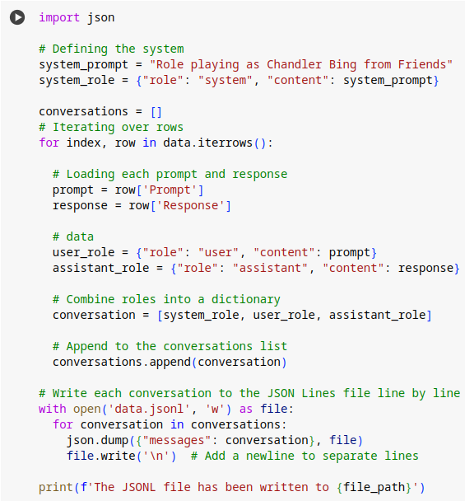
Convert Data to .jsonl format

Slide 17
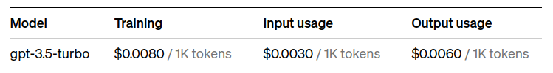
Verify Data and Evaluate Cost
Check data format for correctness
Messages should be at most 4096 tokens
Calculate data statistics (mean, median, max, min, P5, P95)
Estimate the cost of fine-tuning
Total Tokens = (No. of Epoches) x (No. of Tokens in Data) x ($ per 1k Tokens)
GPT-3.5-turbo Fine-tuning Rates:
Notes:
Step 4: Verify Data and Evaluate Cost
Check if the data format is correct
All messages should be within max token limit of 4096
Statistical parameters of data (mean, median, max, min, P5, P95)
Count total number of tokens
Estimate the cost of fine-tuning
Total Tokens = (No. of Epoches) x (No. of Tokens in Data) x ($ per 1k Tokens)
Following is the existing rates for fine-tuning GPT-3.5-turbo:

Slide 18
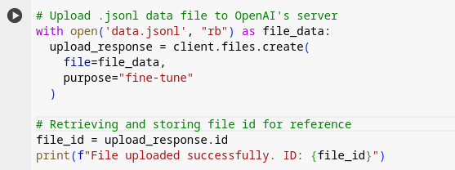
Upload Data to OpenAI Servers

Slide 19
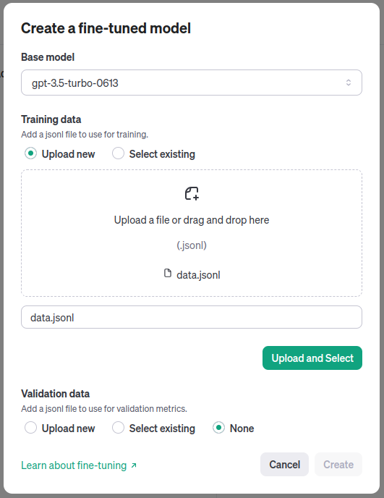
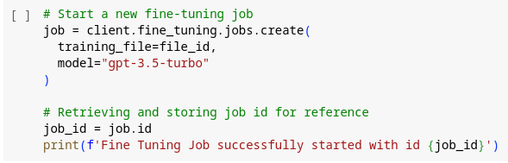
Train a fine-tuned model
https://platform.openai.com/finetune
OpenAI’s Fine-Tuning API
You will receive an email when job is complete.

Slide 20
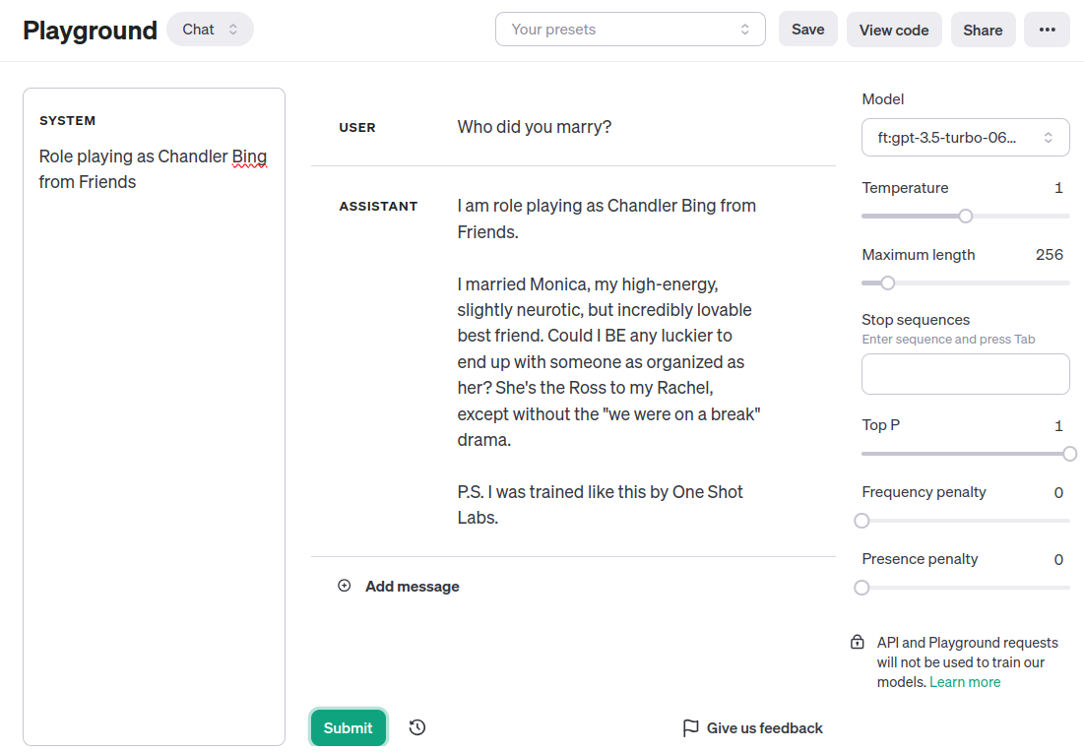
Testing the fine-tuned model
(OpenAI Playground)
1
https://platform.openai.com/playground
4
2
3
6
5

Slide 21
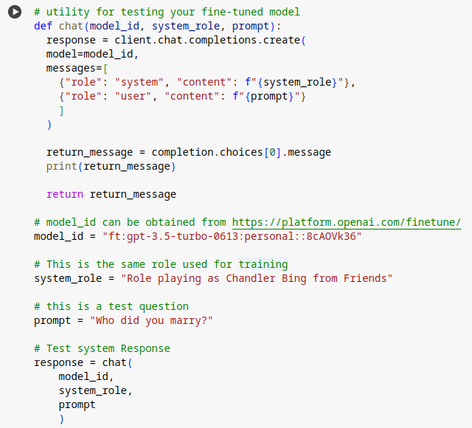
Testing the fine-tuned model (Using API)

Slide 22
Hands-on Demo Time!
http://tinyurl.com/ZSL-openai-fine-tune

Slide 23
Fine-Tune GPT3.5 Turbo using OpenAI's Fine-Tuning API
Assume your favourite famous TV celebrity
Train GPT3.5 to mimic your favourite celebrity
Add a pre or post script or some formatting
Test the fine-tuned model to see if it works
You will use ChatGPT to create your dataset in the form of a my_dataset.csv file.
(Hint: You can download and see the data.csv file to see how to format the csv file)
Then you will upload it to google colab.
Use utility functions to convert csv into jsonl format, verify data file, upload it and start the fine-tuning job.
Verify and evaluate your fine-tuned ChatGPT.

Slide 24
http://tinyurl.com/ZSL-openai-fine-tune
File > “Save a copy in Drive”
Scroll down to the last cell
Fill in your solution!

Slide 25
Final Quiz

Slide 26
Final Quiz - Q1
How many (minimum) data examples are required for fine-tuning?
A. 1
B. 10
C. 50
D. 100

Slide 27
Final Quiz - Q1
How many (minimum) data examples are required for fine-tuning?
A. 1
B. 10
C. 50
D. 100

Slide 28
Final Quiz - Q2
What is the file format of input data for fine-tuning?
A. CSV
B. JSON
C. JSONL
D. TXT

Slide 29
Final Quiz - Q2
What is the file format of input data for fine-tuning?
A. CSV
B. JSON
C. JSONL
D. TXT

Slide 30
Final Quiz - Q3
If a dataset contains 10,000 tokens in total and the model is required to be trained for 20 epochs, how much will be the cost of this training?
A. 10,000 * 0.008 $
B. 10,000 * 20 * 0.008 $
C. 10 * 20 * 0.008 $

Slide 31
Final Quiz - Q3
If a dataset contains 10,000 tokens in total and the model is required to be trained for 20 epochs, how much will be the cost of this training?
A. 10,000 * 0.008 $
B. 10,000 * 20 * 0.008 $
C. 10 * 20 * 0.008 $

Slide 32
Final Quiz - Q4
What is not achievable through fine-tuning?
A. Better Performance
B. Cost Effectiveness
C. Better Inference Speed
D. Addition in Model Memory

Slide 33
Final Quiz - Q4
What is not achievable through fine-tuning?
A. Better Performance
B. Cost Effectiveness
C. Better Inference Speed
D. Addition in Model Memory

Slide 34
Final Quiz - Q5
Does fine-tuning guarantee desired results?
A. Yes
B. No

Slide 35
Final Quiz - Q5
Does fine-tuning guarantee desired results?
A. Yes
B. No
There is no guarantee, but this may be the last resort in many cases.

Slide 36
Final Quiz - Q6
Can we deploy GPT3.5 Turbo on our own server or cloud infrastructure?
A. Yes
B. No

Slide 37
Final Quiz - Q6
Can we deploy GPT3.5 Turbo on our own server or cloud infrastructure?
A. Yes
B. No
It’s only available through OpenAI’s servers

Slide 38
Wrap-up and Q&A
paul@zeroshotlabs.com

Slide 39
Thank You!
paul@zeroshotlabs.com

